Slide 1
Unit 4: Constraint Satisfaction Problems
Madhura Vyawahare

Slide 2
Syllabus
Constraint satisfaction problems
Backtracking search for CSPs
Variables and value ordering
Propagating information through constraints
Intelligent backtracking
Local search for CSP
Case study on CSP

Slide 3
Constraint Satisfaction Problem
Constraint satisfaction is a technique where a problem is solved when its values satisfy certain constraints or rules of the problem.
Such type of technique leads to a deeper understanding of the problem structure as well as its complexity.
Constraint satisfaction depends on three components, namely:
Variables
Domains: where the variables reside. There is a specific domain for each variable.
Constraints: which are followed by the set of variables.
Variable is a decision that must be made and domain is the set of possible values that a variable can take

Slide 4
Constraint Satisfaction Problem: Formal Definition
CSP is defined by 3 components:
V: Finite set of variables = {v1,v2,v3,...vn}
D: Finite set of domains = {d1,d2,d3,....dn}
Each variable has a non empty domain
C: constrains: It specify allowable combination of variables assignment
Each constraint Ci involves some subset of the variables and specifies the allowable combinations of values for that subset.
Ci = (scope; relation)
Scope: set of variables that participate in constraint
Relations: values that a variable can take

Slide 5
Constraint Satisfaction Problem
Variables are v1 and v2
v1 is from domain A and v2 from domain B
Constraint is v1 and v2 can't be same.
Ci = {(v1,v2), (v1!=v2)}
Or
Ci = {(v1,v2), (A,B)}

Slide 6
Constraint Satisfaction Problem Definition
Examples:
Sudoku (81,(1 to 9), same row and same column should not repeat any number)
Node/Graph coloring problem:
(all nodes, colors, no neighbouring nodes should have same color)
CSP can be visualized as graph for simplicity

Slide 7
Variables
An assignment of values to a variable can be done in three ways:
Consistent or Legal Assignment: An assignment which does not violate any constraint or rule is called Consistent or legal assignment.
Complete Assignment: An assignment where every variable is assigned with a value.
Partial Assignment: An assignment which assigns values to some of the variables only. Such type of assignments are called Partial assignments.
Solution to CSP is complete and Legal assignment of variables!

Slide 8
Types of Domains in CSP
There are following two types of domains which are used by the variables :
Discrete Domain: countable set of possible values that a variable can take
For example: consider a scheduling problem where you need to assign tasks to a set of workers.
Variables: the worker assignments for each task
domain: set of workers available to perform the task.
Continuous Domain: set of real numbers that can take any value within a given range
Optimization problem where you need to find the minimum value of a function.

Slide 9
Constraint Types in CSP
Constraint Types in CSP
With respect to the variables, basically there are following types of constraints:
Unary Constraints: It is the simplest type of constraints that restricts the value of a single variable.
Binary Constraints: It is the constraint type which relates two variables. A value x2 is not equal to x1.
Local Constraints: Applicable to single or pair of variables. A value x2 is not x1 and x3.
Global Constraints: It is the constraint type which involves an arbitrary number of variables.
Linear Constraints: These type of constraints are commonly used in linear programming where each variable containing an integer value exists in linear form only. X + 2Y - 3Z = 10.
Non-linear Constraints: These type of constraints are used in non-linear programming where each variable (an integer value) exists in a non-linear form. X^2 + Y^2 = 25.

Slide 10
Constraint Satisfaction Problem
A state of the problem is defined by an assignment of values to some or all of the variables
Legal / consistent Assignment: does not violate any constraint
Complete assignment: every variable is mentioned
Solution to CSP: complete assignment that satisfies all the constraints
Some CSPs also require a solution that maximizes an objective function
CSP uses intelligent Backtracking

Slide 11
Constraint Propagation
In local state-spaces, the choice is only one, i.e., to search for a solution.
But in local search for CSP, we have two choices either:
We can search for a solution or
We can perform a special type of inference called constraint propagation.
Constraint propagation is a fundamental technique used in Constraint Satisfaction Problems (CSPs) to reduce the search space and improve the efficiency of solving such problems.
It involves the application of constraints to prune or eliminate possible values for variables based on the information available in the problem.
Constraint propagation is assigning the value to variable in such a way that it satisfies some constraint
Use the information contained in the constraints to eliminate values that cannot possibly be part of a solution
This process helps to prune the search space by reducing the number of possibilities that need to be considered, and can often lead to a faster solution.

Slide 12
Constraint Propagation
Forward Checking: This technique checks each constraint as it is added to the CSP and eliminates values from the domains of other variables that are inconsistent with the constraint.
Arc Consistency: This technique checks for consistency between every pair of variables in the CSP and eliminates values from the domains of variables that are inconsistent with the constraints. Uses Queue mostly. Example: Variables are A, B, C. Start with A and B or A and C or B and C.
Domain Splitting: This technique splits the domain of a variable into multiple sub-domains and assigns each sub-domain to a different branch in the search tree. Example: Domain of A: {1, 2, 3, 4, 5, 6, 7, 8, 9}. Split: {1,3,5,7,9}{2,4,6,8} or {1,2,3,4,5}{6,7,8,9} or {1, 2, 3}{4, 5, 6, 7, 8, 9}.
Domain Filtering: This technique eliminates values from the domain of a variable that do not satisfy a particular constraint. It is often applied as part of the initial preprocessing or during the CSP-solving process to make the problem more manageable. Example: X+Y<6

Slide 13
Constraint Propagation
It can be an effective technique for reducing the search space in a CSP
It can also be time-consuming and may not always lead to a solution
It may be necessary to use a combination of constraint propagation and other search techniques, such as backtracking, to find a solution to a CSP.

Slide 14
Constraint Satisfaction Problem Definition
Examples:
Sudoku (81,(1 to 9), same row and same column should not repeat any number)
Graph coloring problem:
(all nodes, colors, no neighbouring nodes should have same color)
CSP can be visualized as graph for simplicity

Slide 15
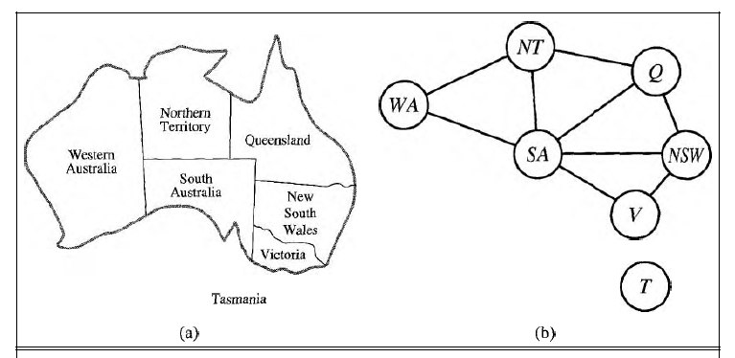

Slide 16
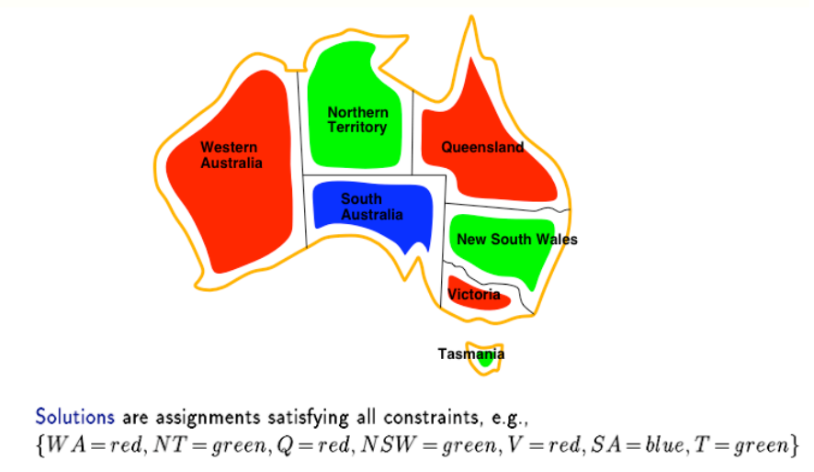

Slide 17
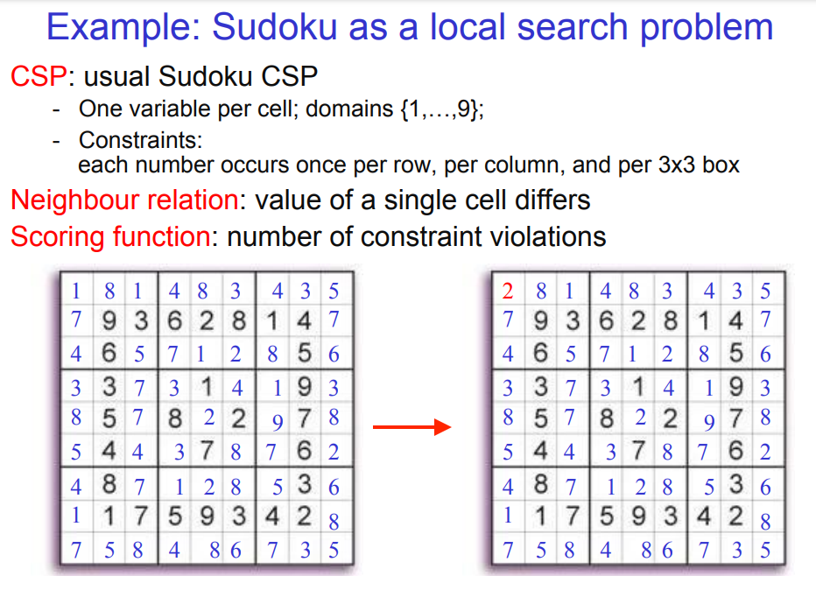

Slide 18
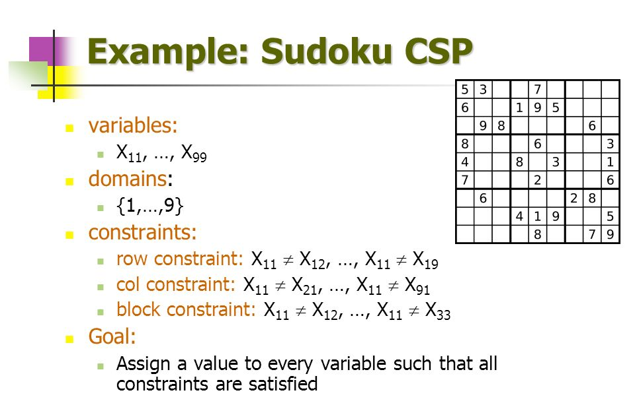

Slide 19
Crypt Arithmetic Problem
Crypt arithmetic Problem is a type of constraint satisfaction problem where the game is about digits and its unique replacement either with alphabets or other symbols.
In crypt arithmetic problem, the digits (0-9) get substituted by some possible alphabets or symbols.
The task in cryptarithmetic problem is to substitute each digit with an alphabet to get the result arithmetically correct.

Slide 20
Crypt Arithmetic Problem
The rules or constraints on a cryptarithmetic problem are as follows:
Digits should be from 0-9 only
One letter should have one value only
No two letters can have same value
There should be a unique digit to be replaced with a unique alphabet.
Sum of arithmetic values should satisfy the sum of words
The result should satisfy the predefined arithmetic rules, i.e., 2+2 =4, nothing else.
There should be only one carry forward, while performing the addition operation on a problem.
The problem can be solved from both sides, i.e., left hand side (L.H.S), or right hand side (R.H.S)

Slide 21
Crypt Arithmetic Problem
Problems:
TO+GO = OUT
SEND + MORE = MONEY
YOUR+YOU=HEART
CROSS + ROAD = DANGER

Slide 22
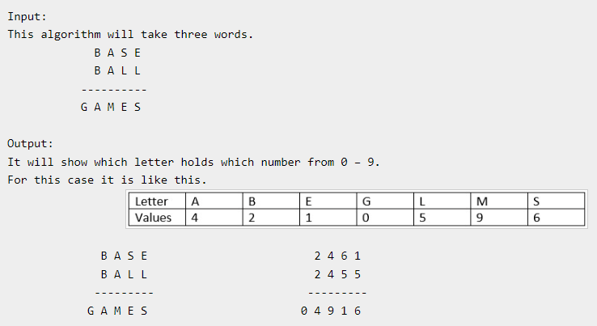

Slide 23
SOLUTIONS
TO+DO=OUT 21+81=102
YOUR+YOU= HEART 9426+942=10368
SEND+MORE=MONEY 9567+1085= 10652
CROSS+ROADS=DANGER 96233+62513=158746

